Slide 1
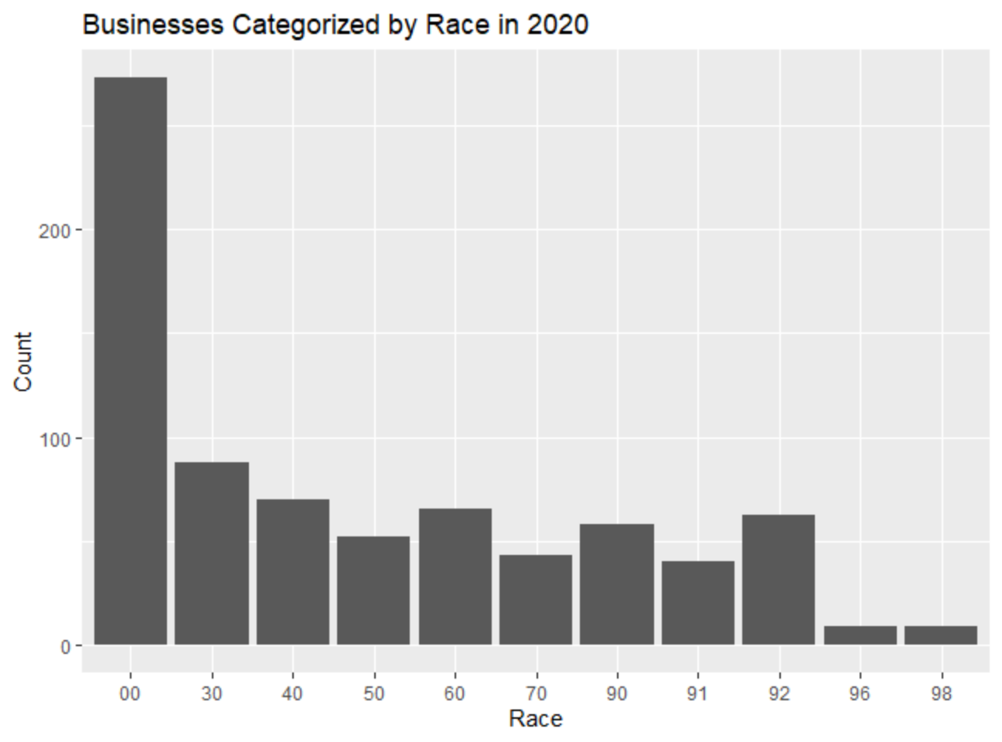
Must ignore the first value “00” since it accounts for the total of all races.
Majority of businesses owners were white, Caucasian
Second dominating race were black, African-American owners

Slide 2
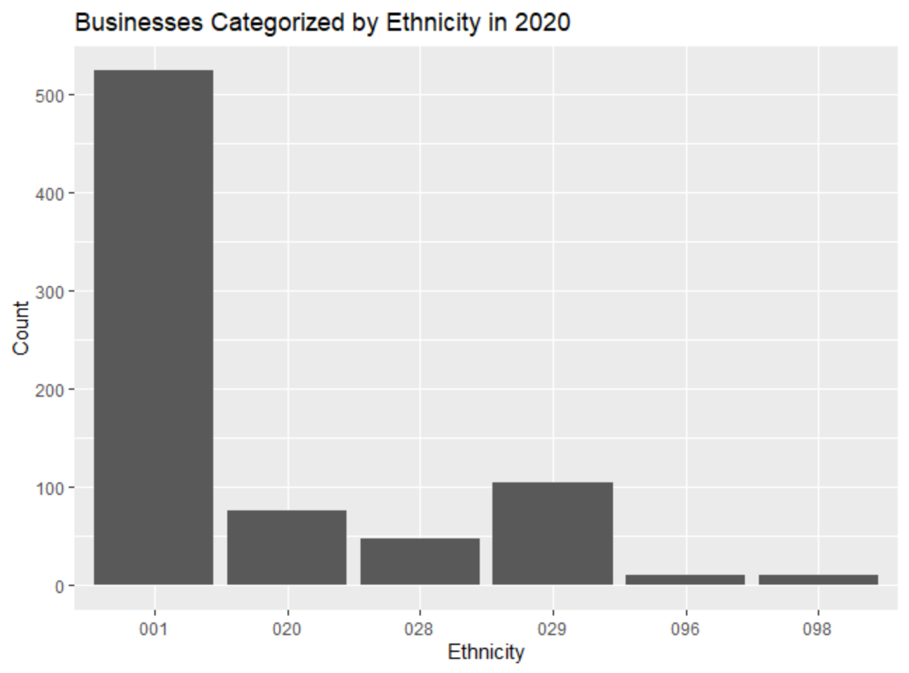
Must ignore the first value “001” since it accounts for the total of all races.
Majority of businesses owners’ ethnicity were non-Hispanic
While in second, were business owners that were Hispanic

Slide 3
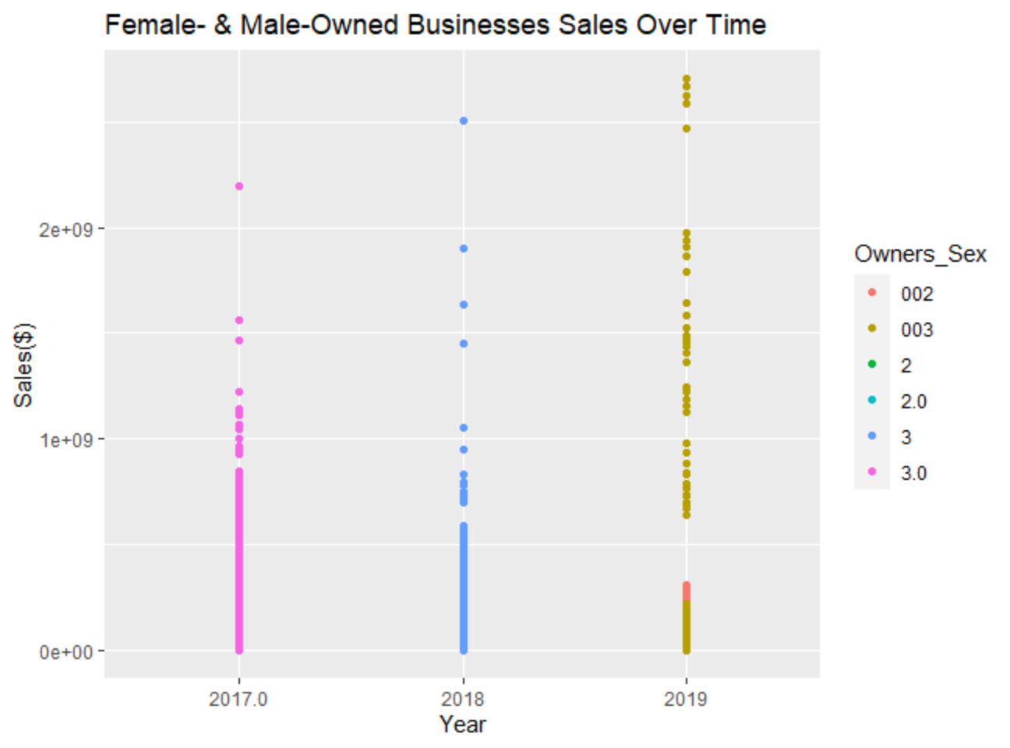
Datapoints are concentrated between each year
Shows a slight positive, upward trend

